Slide 1
Power Laws: Rich-Get-Richer Phenomena
Chapter 18: “Networks, Crowds and Markets”
By Amir Shavitt

Slide 2
Popularity
How do we measure it?
How does it effect the network?
Basic network models with popularity

Slide 3
Popularity Examples
Books
Movies
Music
Websites

Slide 4
Our Model
course homepage
The web as a directed graph
Nodes are webpages
Edges are hyperlinks
#in-links = popularity
1 out-link per page
www.cs.tau.ac.il
www.eng.tau.ac.il
www.tau.ac.il

Slide 5
Our Main Question
As a function of k, what fraction of pages on the web have k in-links?

Slide 6
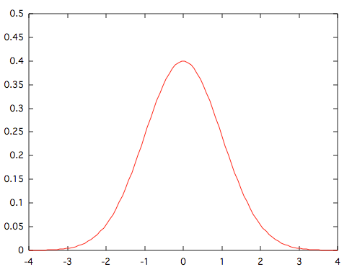
Expected Distribution
Normal distribution
Each link addition is an experiment

Slide 7
Power Laws
f(k) ∼ 1/k^{c}
Usually c > 2
Tail decreases much slower than the normal distribution

Slide 8
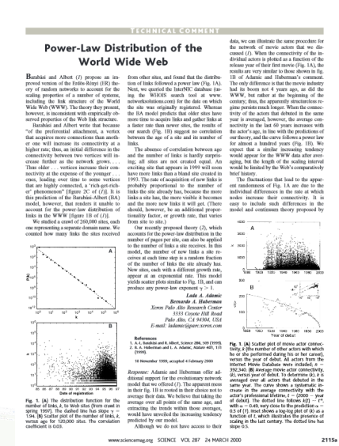
Examples
Telephone numbers that receive k calls per day
Books bought by k people
Scientific papers that receive k citations

Slide 9
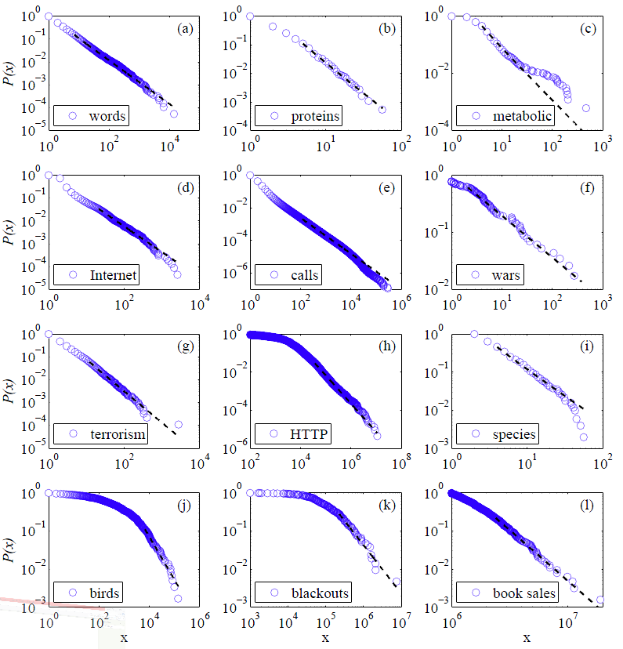
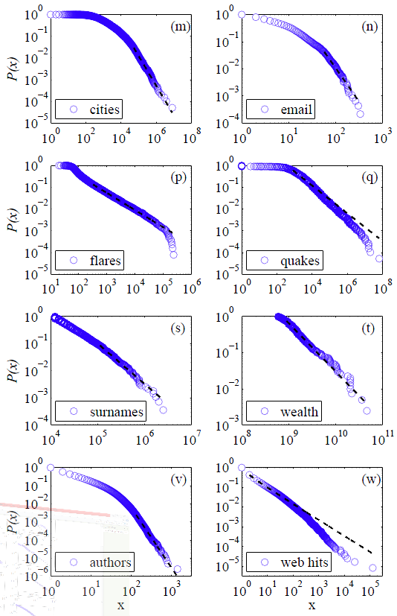
Power Laws Graphs Examples

Slide 10
Power Laws vs Normal Distribution
Normal distribution – many independent experiments
Power laws – if the data measured can be viewed as a type of popularity

Slide 11
What causes power laws?
Correlated decisions across a population
Human tendency to copy decisions

Slide 12
Our Model
course homepage
The web as a directed graph
Nodes are webpages
Edges are hyperlinks
#in-links = popularity
1 out-link per page
www.cs.tau.ac.il
www.eng.tau.ac.il
www.tau.ac.il

Slide 13
Building a Simple Model
Webpages are created in order 1,2,3,…,N
Dynamic network growth
When page j is created, with probability:
p: Chooses a page uniformly at random among all earlier pages and links to it
1-p: Chooses a page uniformly at random among all earlier pages and link to its link

Slide 14
Example
1-p
p

Slide 15
Results
y = 835043x^{-2.652}
y = 78380⋅k^{-2.025}

Slide 16
Conclusions
p gets smaller → more copying → the exponent c gets smaller
More likely to see extremely popular pages

Slide 17
Rich-Get-Richer
With probability (1-p), chooses a page k with probability proportional to k’s #in-links
A page that gets a small lead over others will tend to extend this lead

Slide 18
Initial Phase
Rich-get-richer dynamics amplifies differences
Sensitive to disturbance
Similar to information cascades

Slide 19
How Sensitive?
Music download site with 48 songs
8 “parallel” copies of the site
Download count for each song
Same starting point
World 1
Social influence condition
Subjects
World 8
Independent condition
World

Slide 20
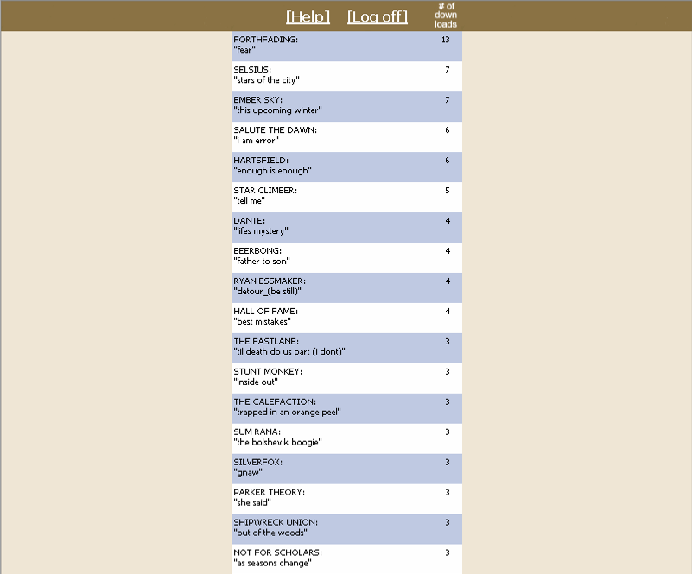
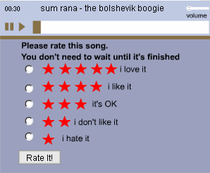
How many people have chosen to download this song?
Source: Music Lab, http://www.musiclab.columbia.edu/

Slide 21
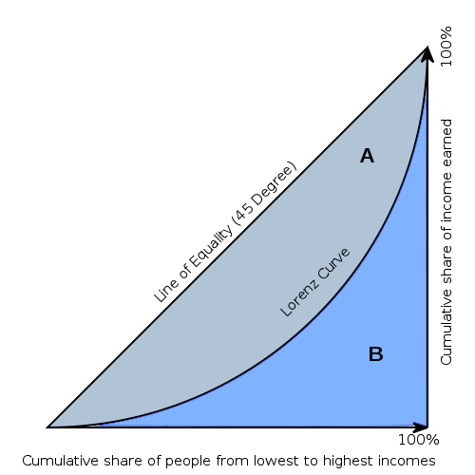
Results
Exp. 1: songs shown in random order
Exp. 2: songs shown in order of download popularity
Gini = A / (A + B)
The Lorenz curve is a graphical representation of the cumulative distribution function

Slide 22
Gini Coefficient
sum of downloads of all songs with rank ≤ i

Slide 23
Findings
Best songs rarely did poorly
Worst songs rarely did well
Anything else was possible
The greater the social influence, the more unequal and unpredictable the collective outcomes become

Slide 24
Zipf Plot
Zipf plot - plotting the data on a log-log graph, with the axes being log (rank order) and log (popularity)
popularity
rank order

Slide 25
The Long Tail
p=0.1
n=1,000,000
Tail contains
990,000 nodes
What number of items have popularity at least k?

Slide 26
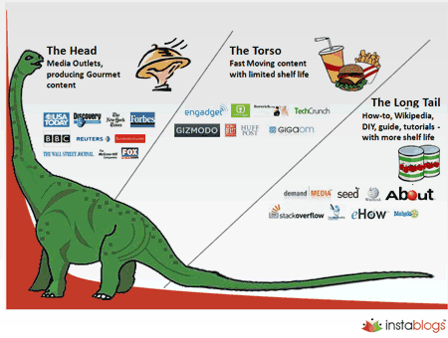

Slide 27
Why is it Important?

Slide 28
Search Tools and Recommendation Systems
How does it effect rich-get-richer dynamics?
How do we find niche products?

